Slide 1
Weekly meeting
5 2 2024
Ty Bottorff

Slide 2
Outline
P576-1 PCAs, VPs, KEGG, comparing to P452

Slide 3
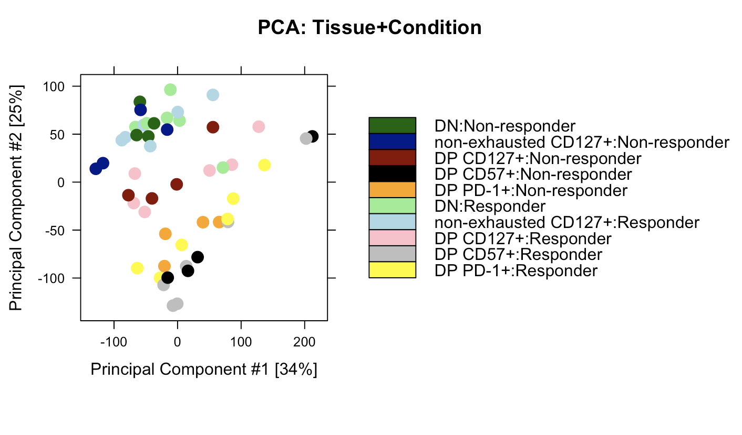
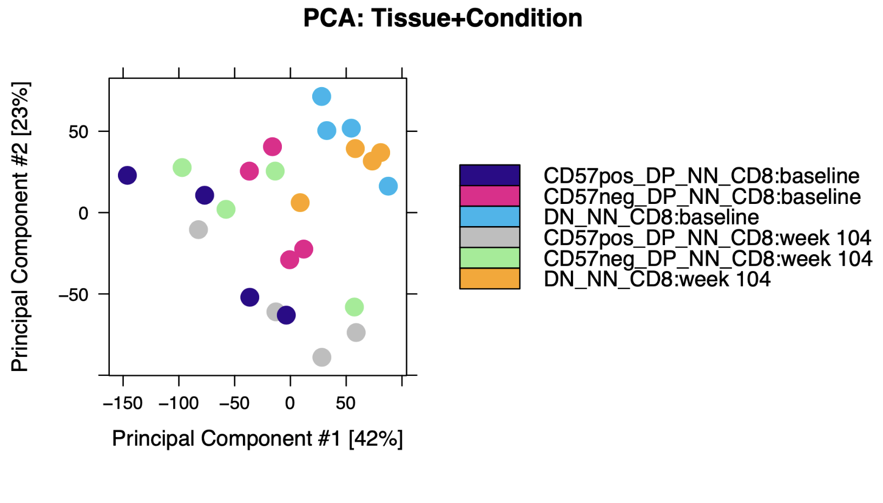
Variability among replicates not very different from P452
P576
P452 (Erin’s)

Slide 4
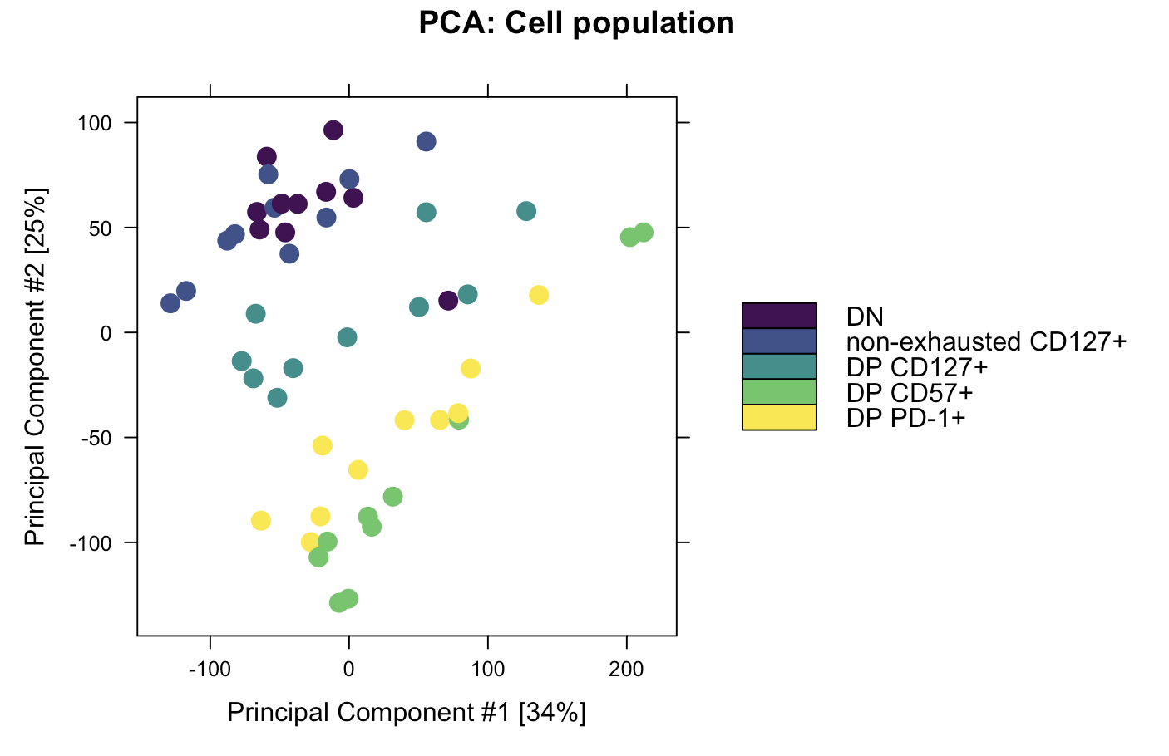
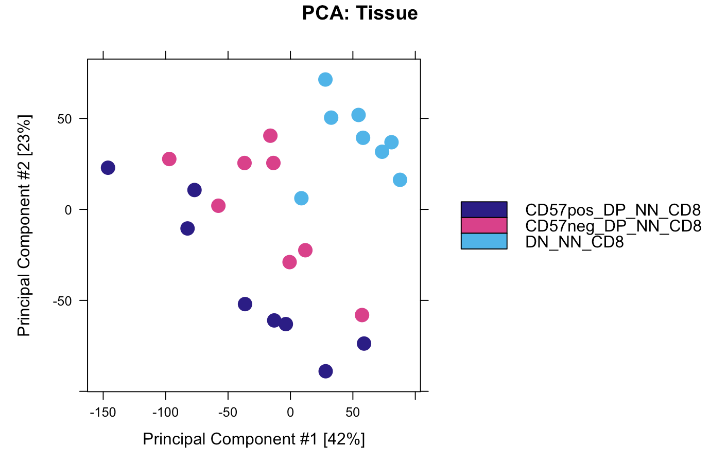
DN and non-exhausted CD127⁺ cluster closely, as do DP PD-1⁺ and DP CD57⁺. DP CD127⁺ appears to be distinct, non-intermediate cell state from DP PD-1⁺ and DP CD57⁺
P576
P452 (Erin’s)
Notes:
Rows in heatmap are peaks?

Slide 5
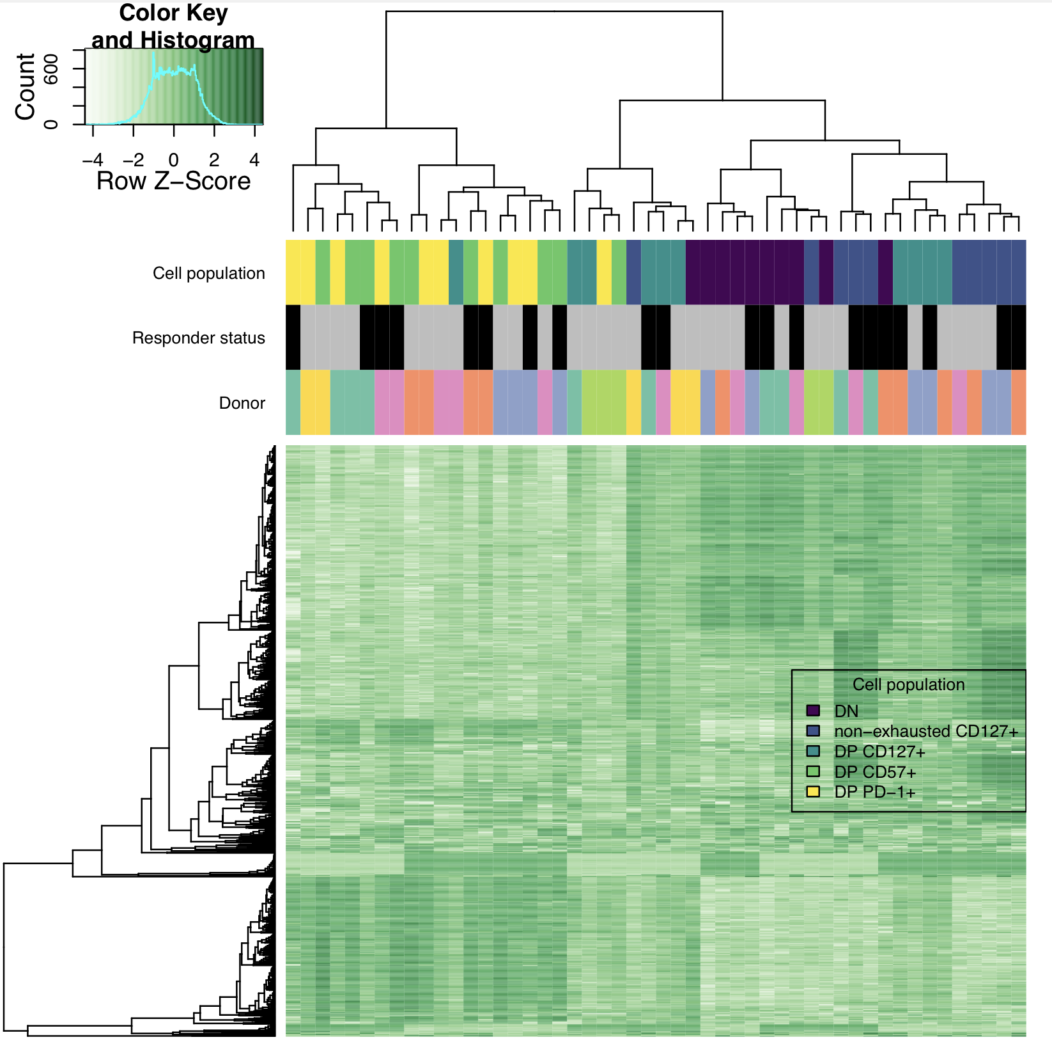
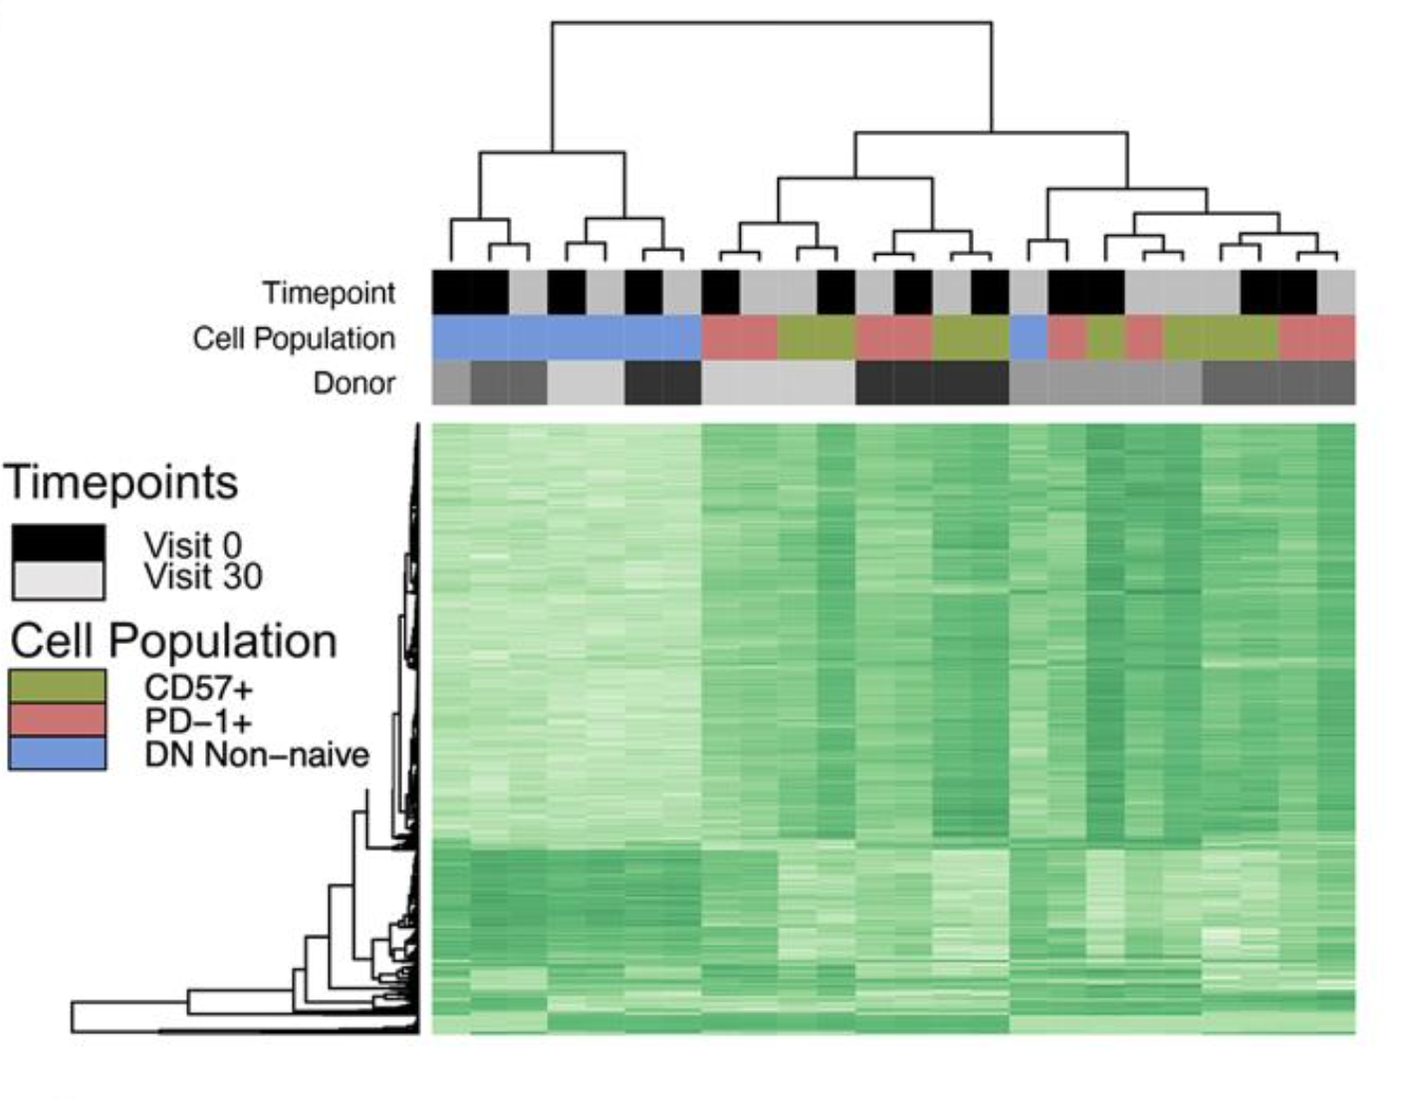
Alternative plot to show cell population clustering
P576
P452 (Erin’s)
Notes:
Rows in heatmap are peaks?

Slide 6
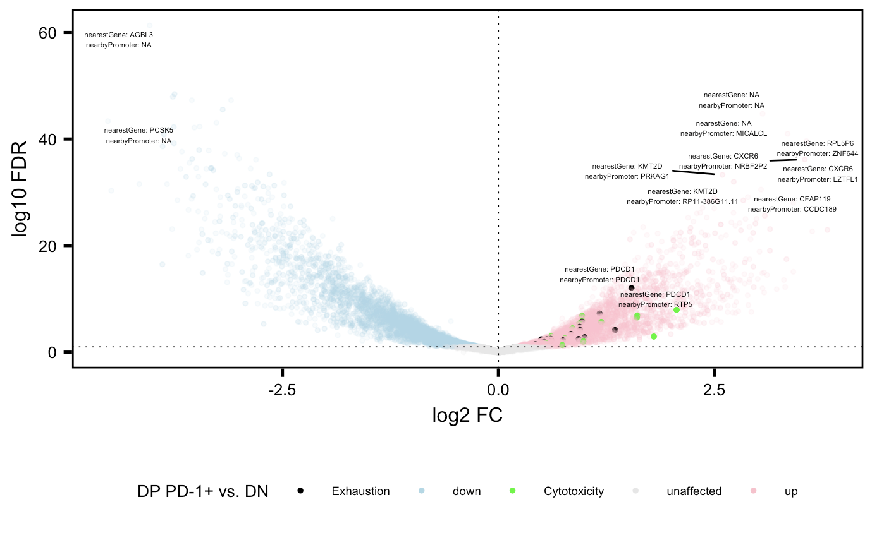
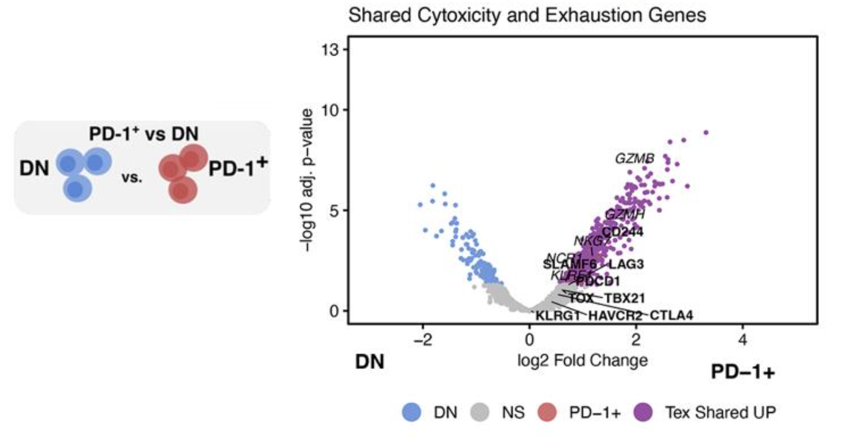
Cytotoxicity and exhaustion genes more accessible in DP PD-1⁺ relative to DN in both projects
P576
P452 (Erin’s)

Slide 7
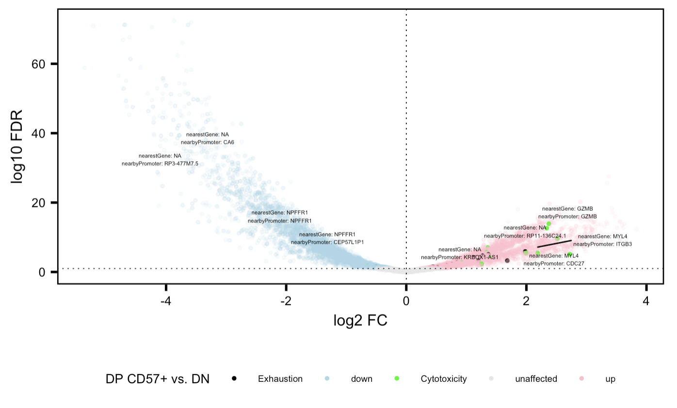
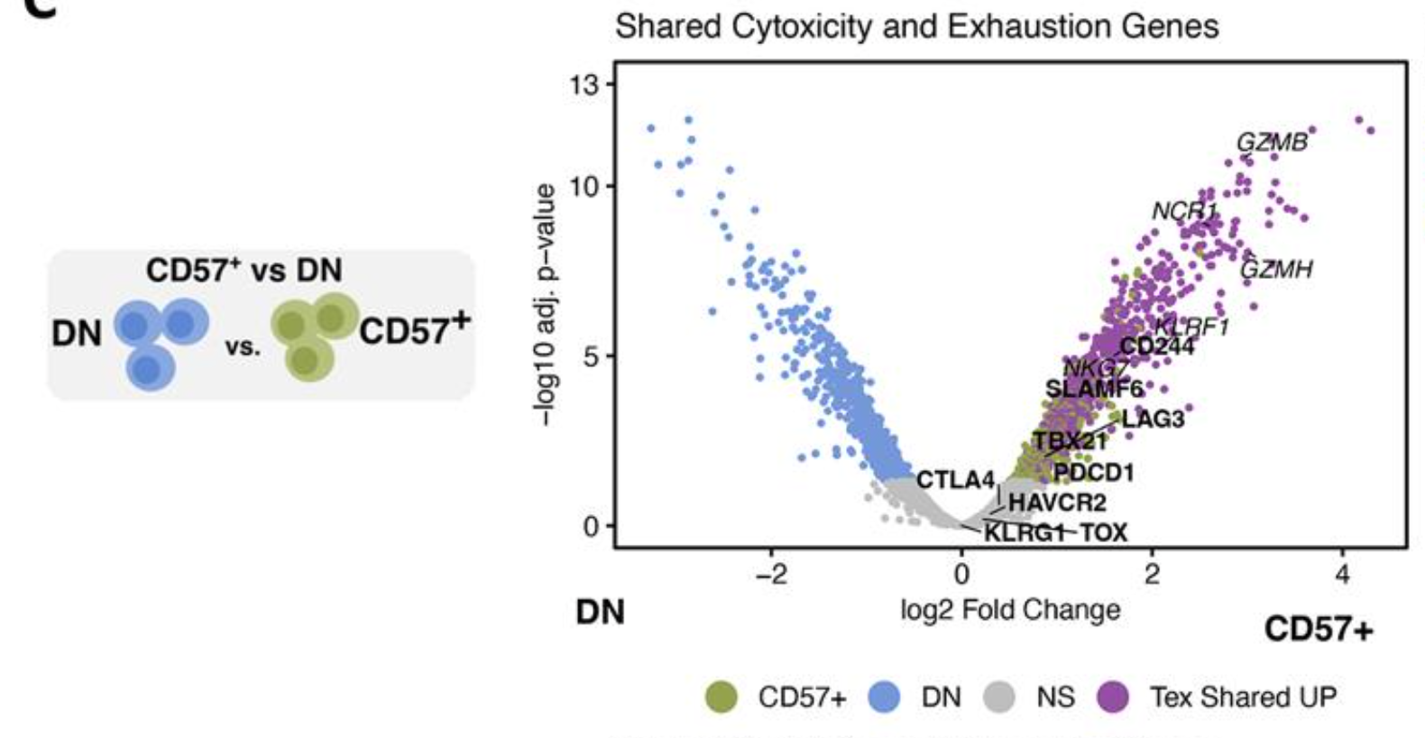
Cytotoxicity and exhaustion genes more accessible in DP CD57⁺ relative to DN in both projects
P576
P452 (Erin’s)

Slide 8
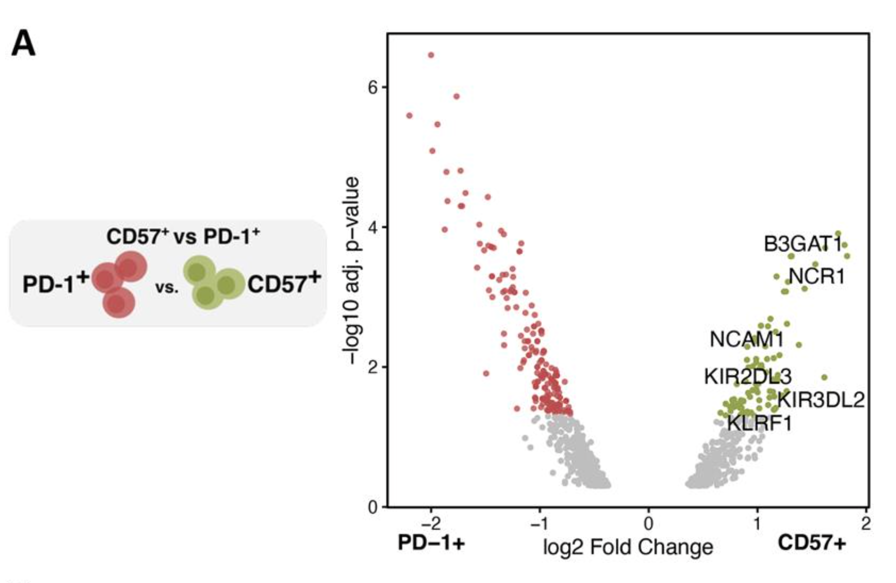
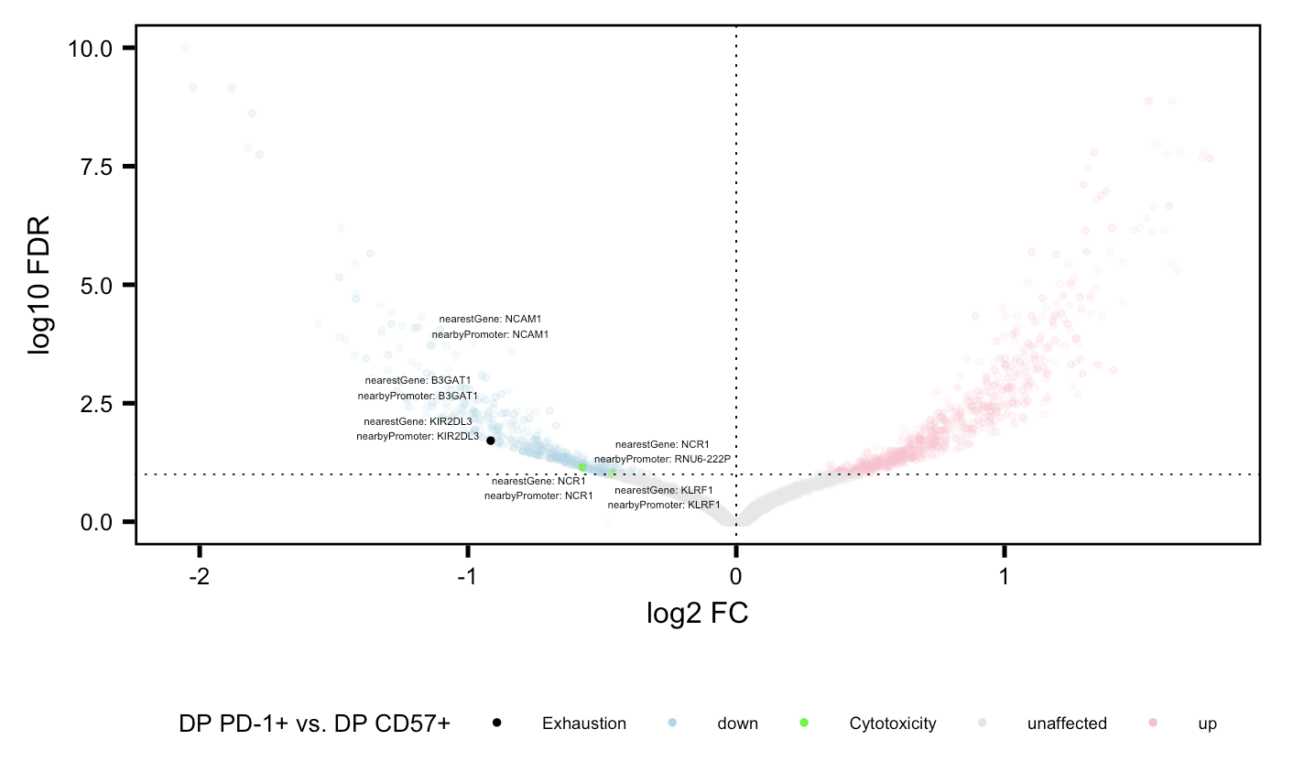
Same genes more accessible in CD57⁺ relative to PD-1⁺ in both projects
P576
P452 (Erin’s)

Slide 9
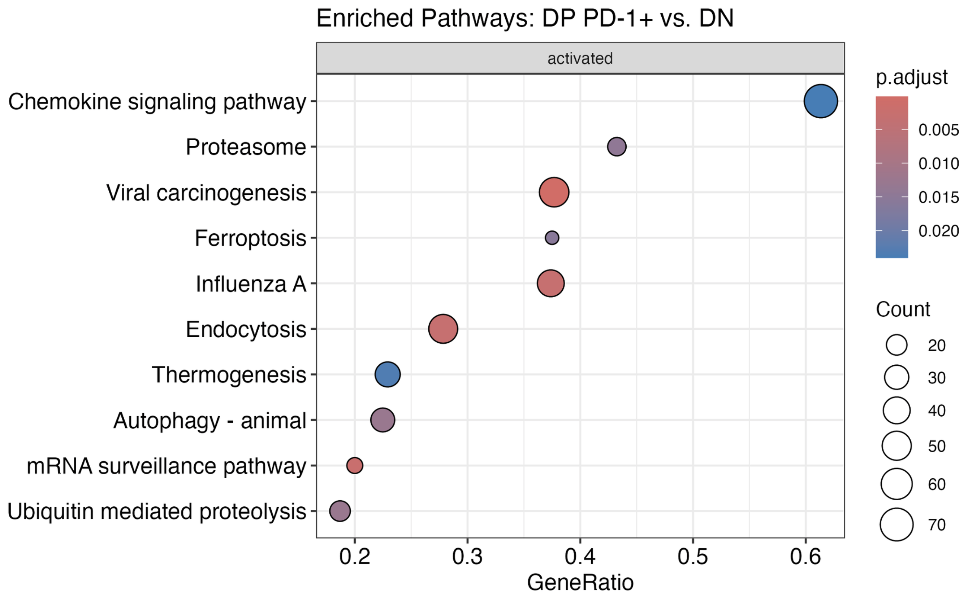
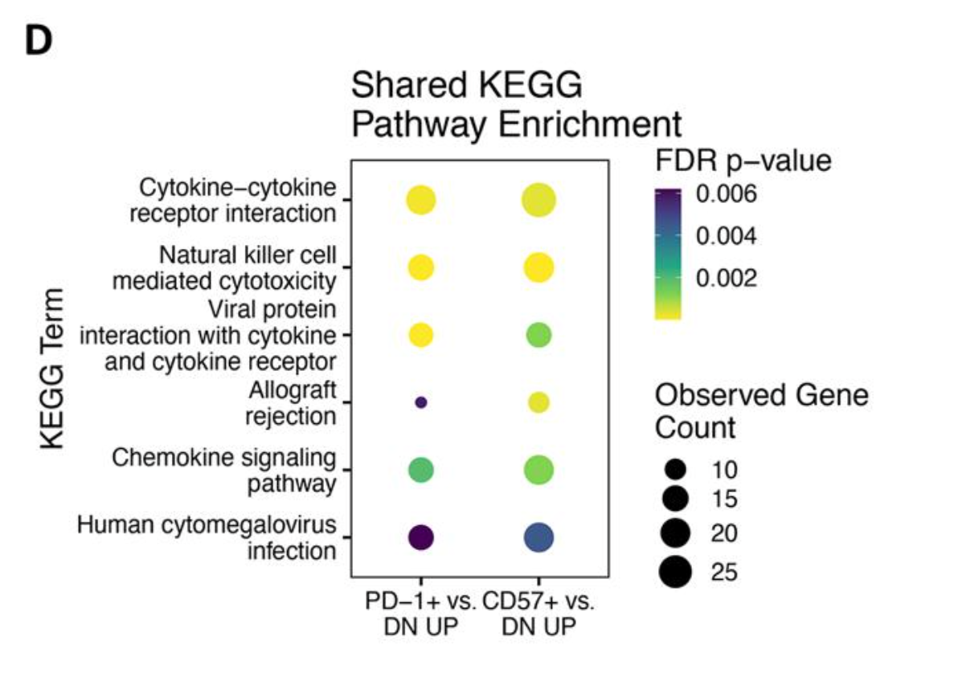
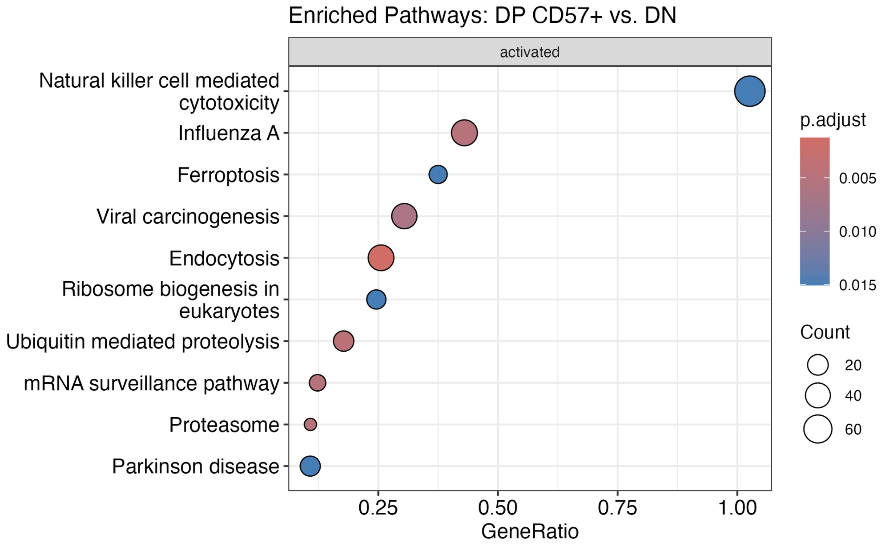
KEGG analysis not very similar between projects (methodology?)
!
!
!
!
P576
P452 (Erin’s)

Slide 10
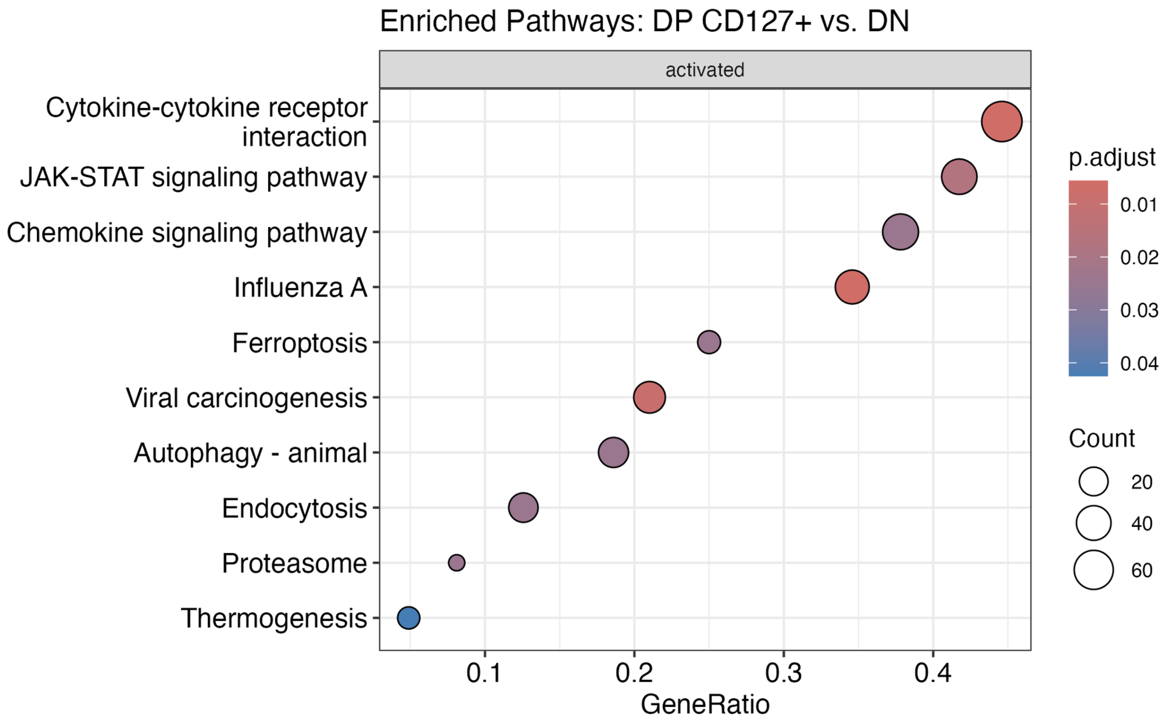
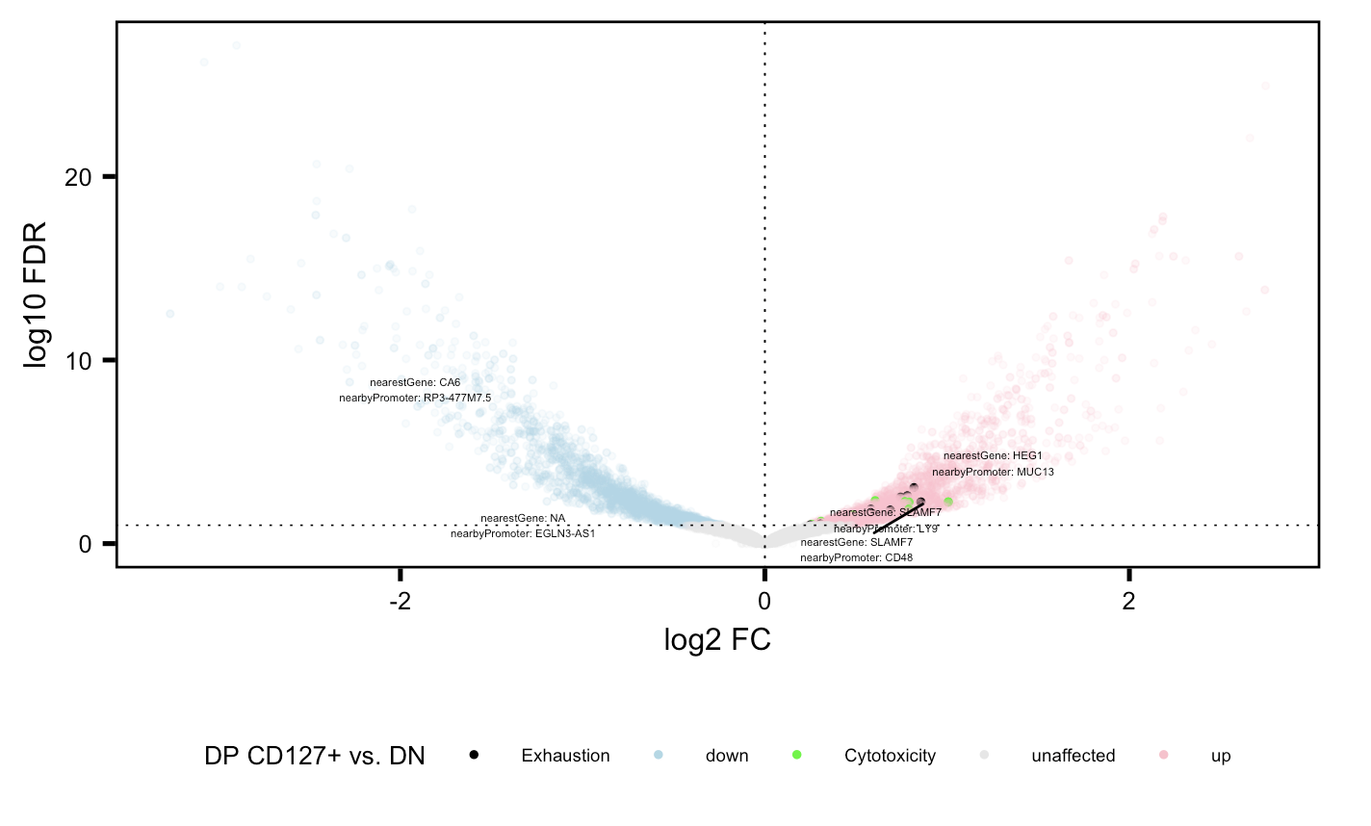
Cytotoxicity and exhaustion genes more accessible in DP CD127⁺ relative to DN

Slide 11
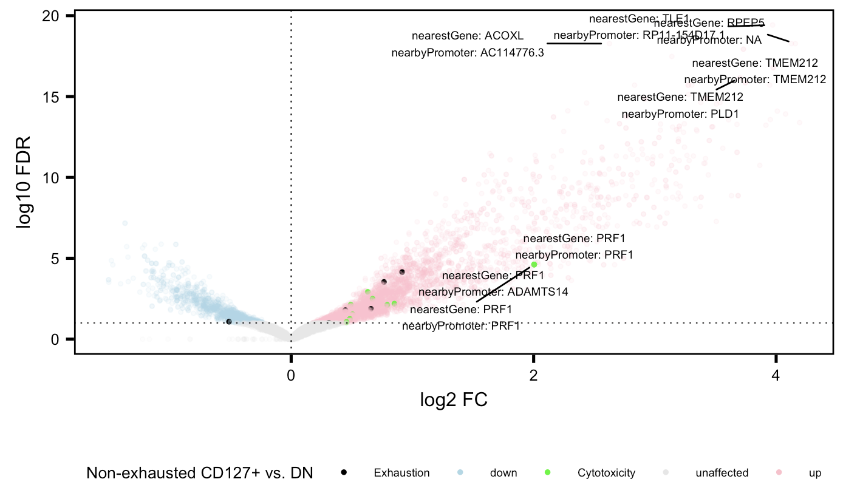
Cytotoxicity and exhaustion genes more accessible in non-exhausted CD127⁺ relative to DN
Notes:
No KEGG results

Slide 12
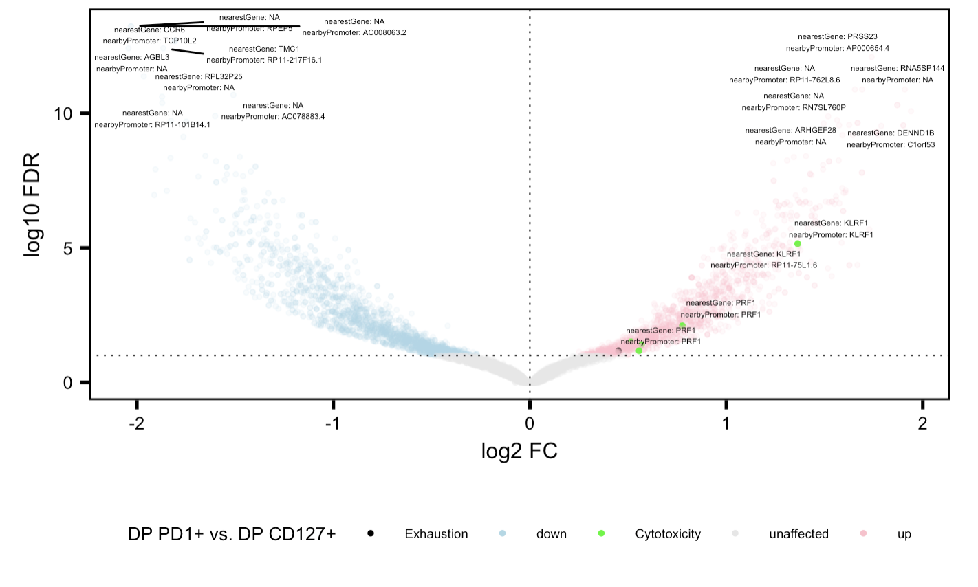
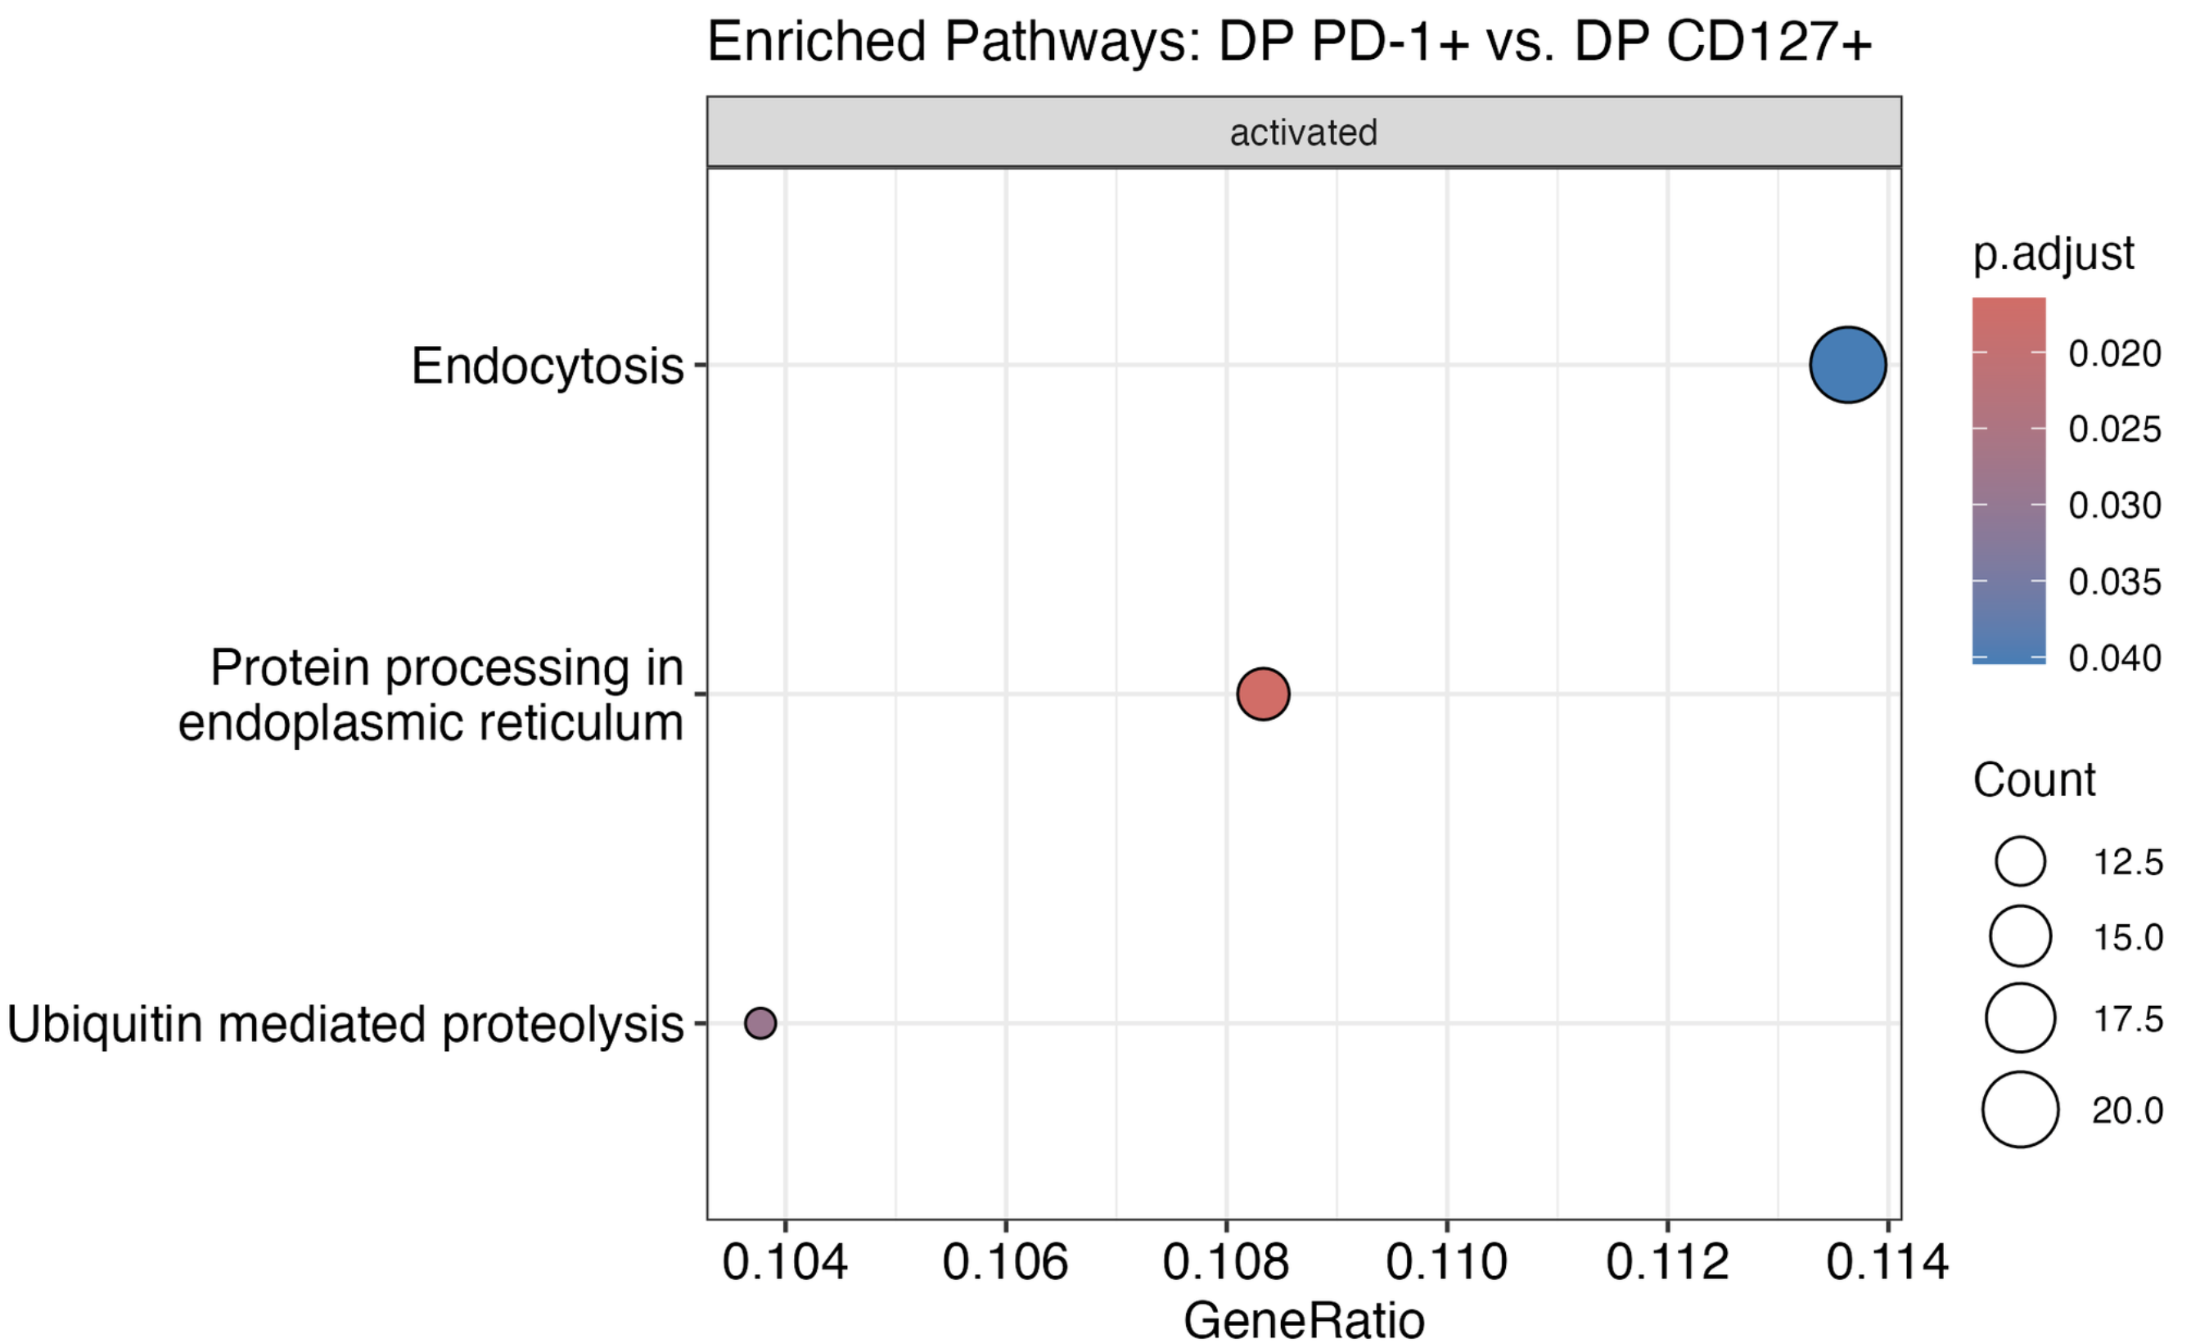
Cytotoxicity genes more accessible in DP PD-1⁺ relative to DP CD127⁺

Slide 13
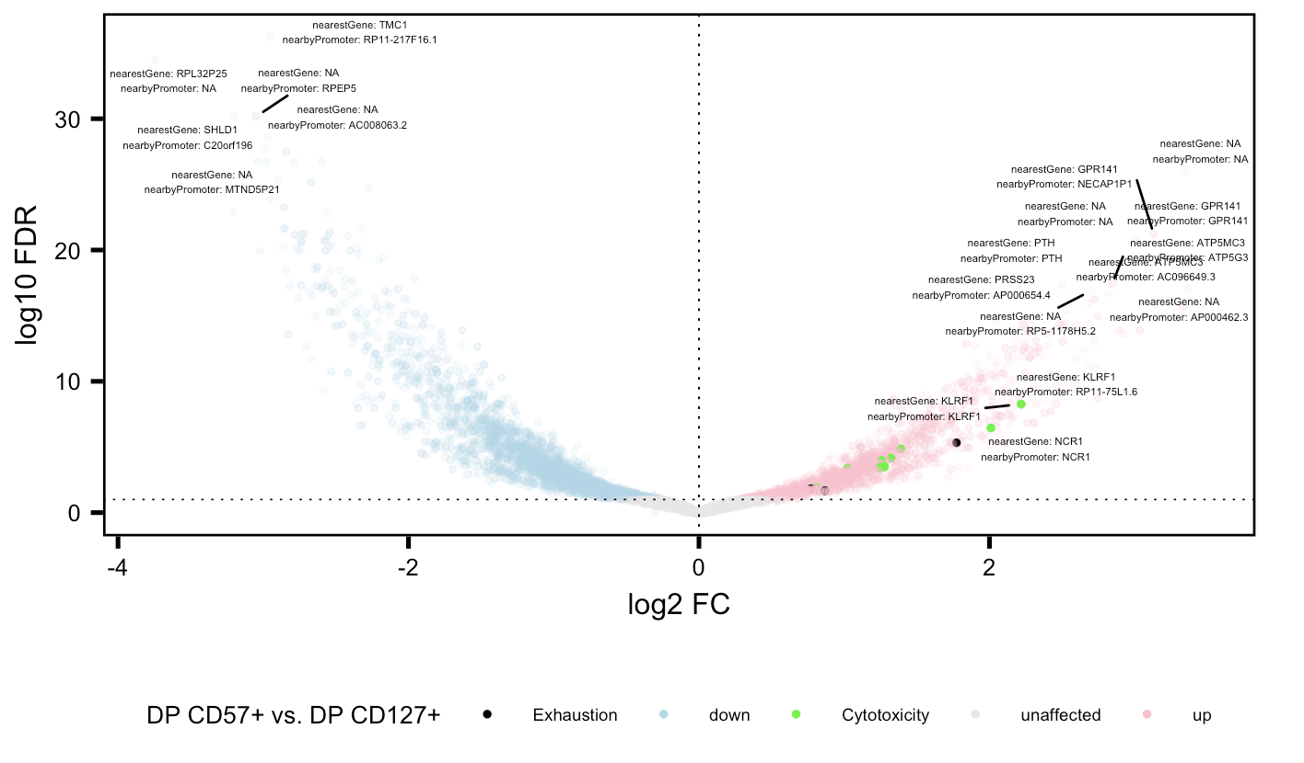
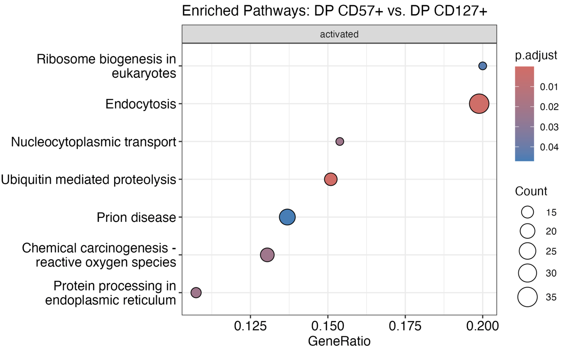
Cytotoxicity and exhaustion genes more accessible in DP CD57⁺ relative to DP CD127⁺

Slide 14
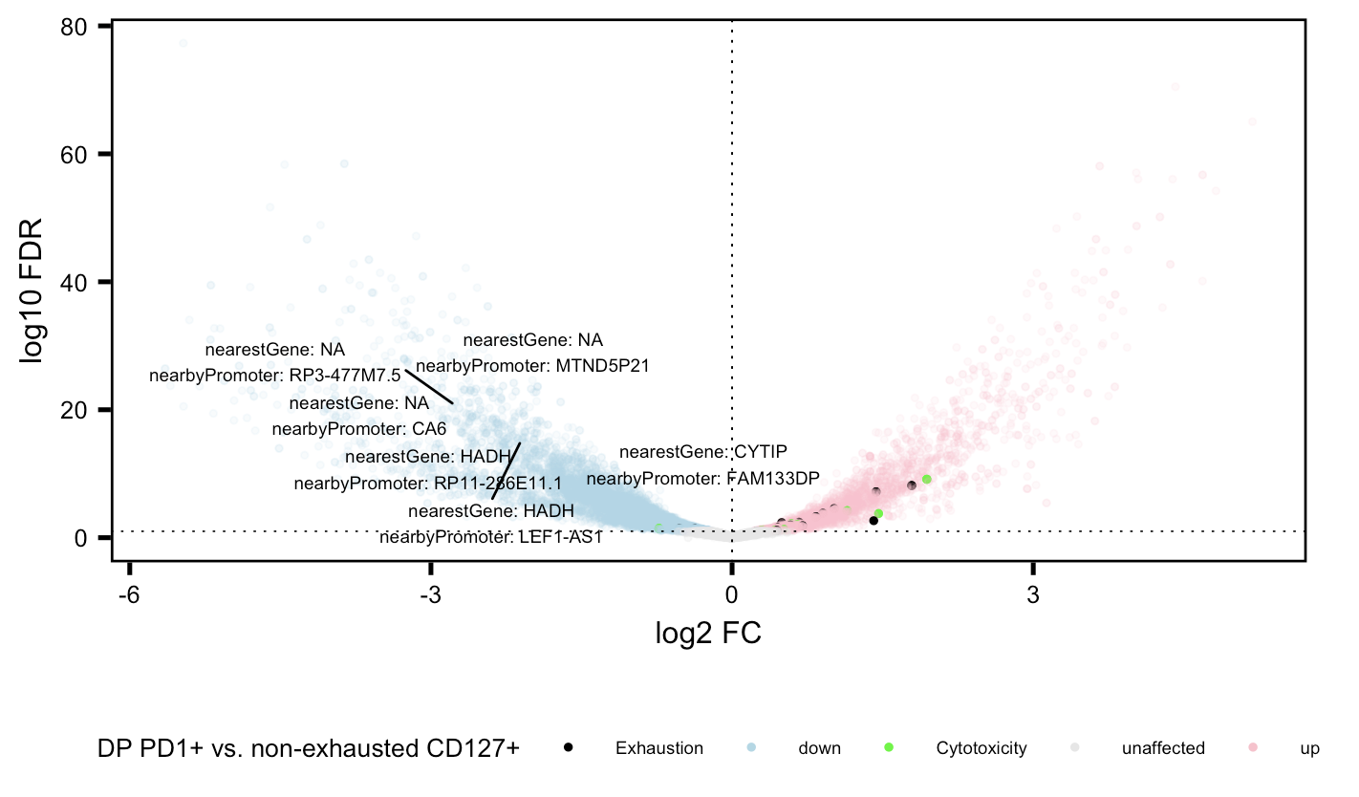
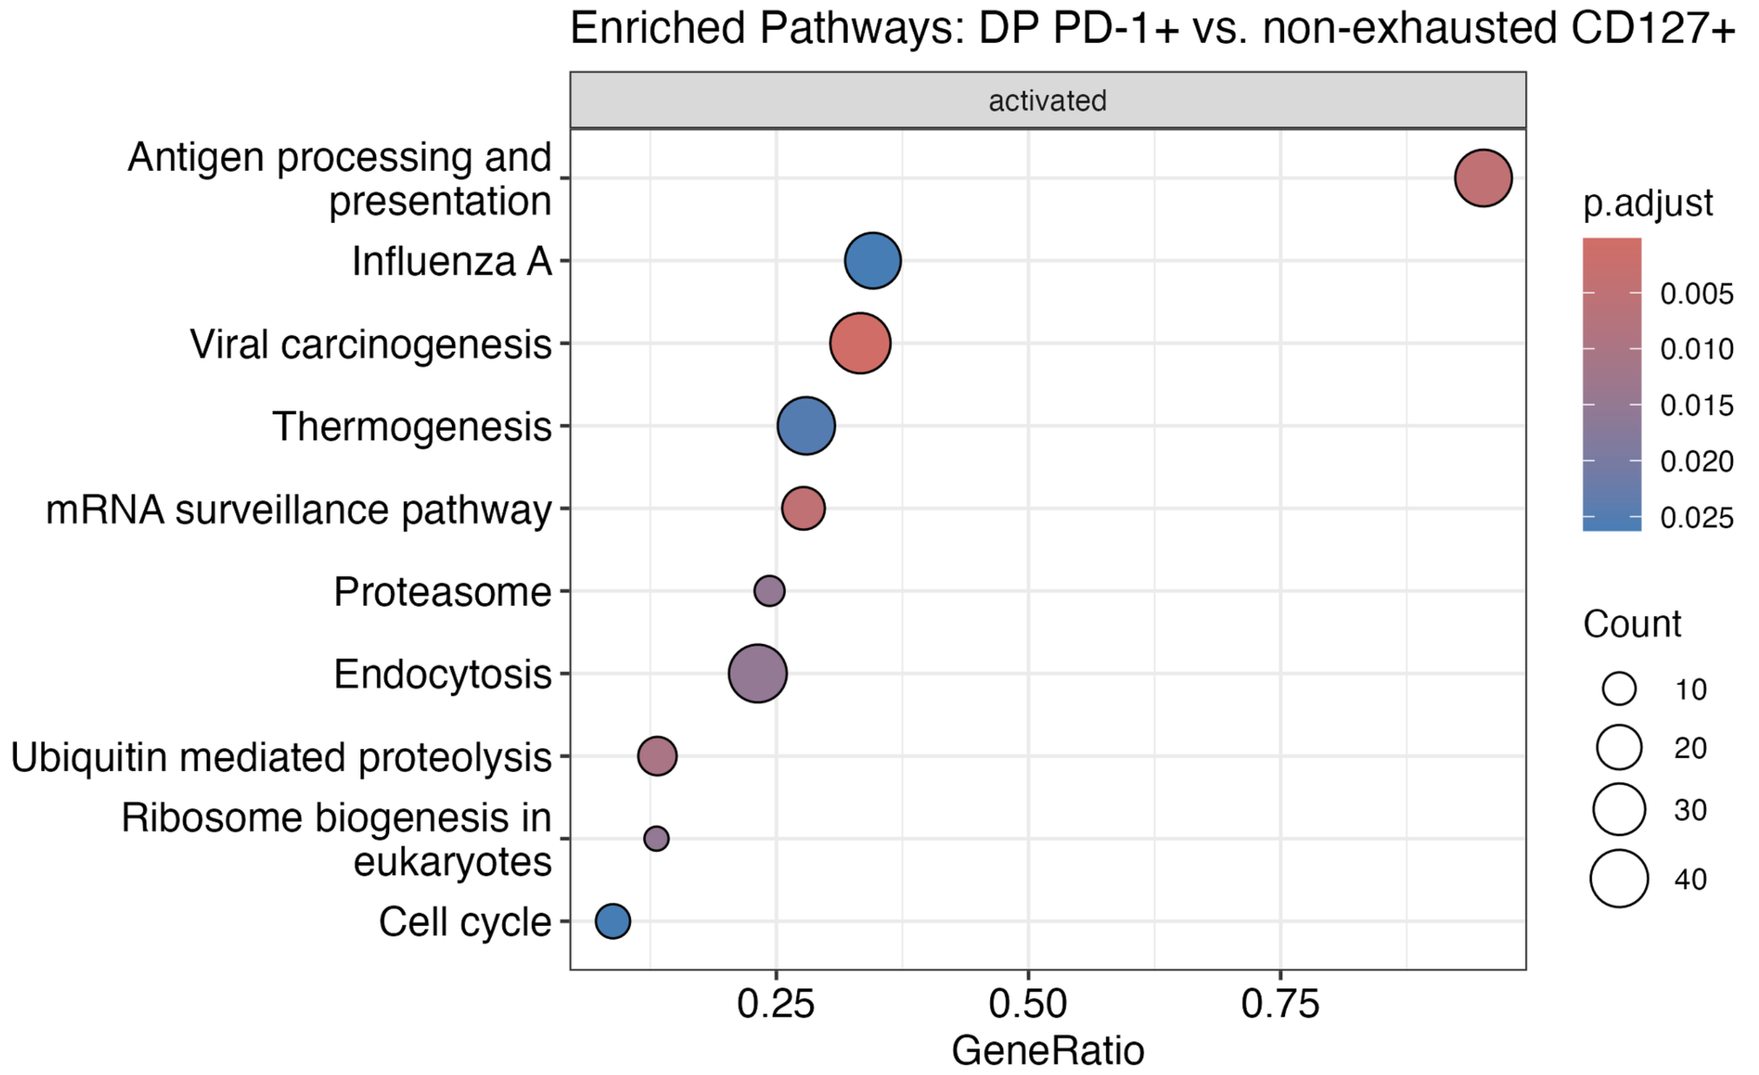
Cytotoxicity and exhaustion genes more accessible in DP PD-1⁺ relative to non-exhausted CD127⁺

Slide 15
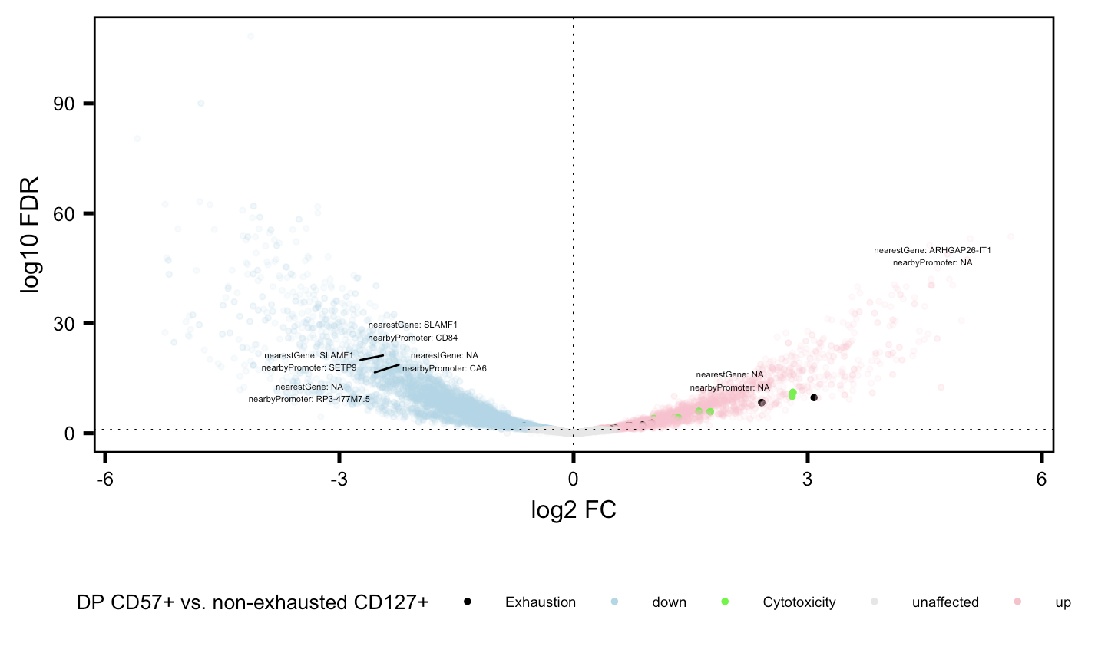
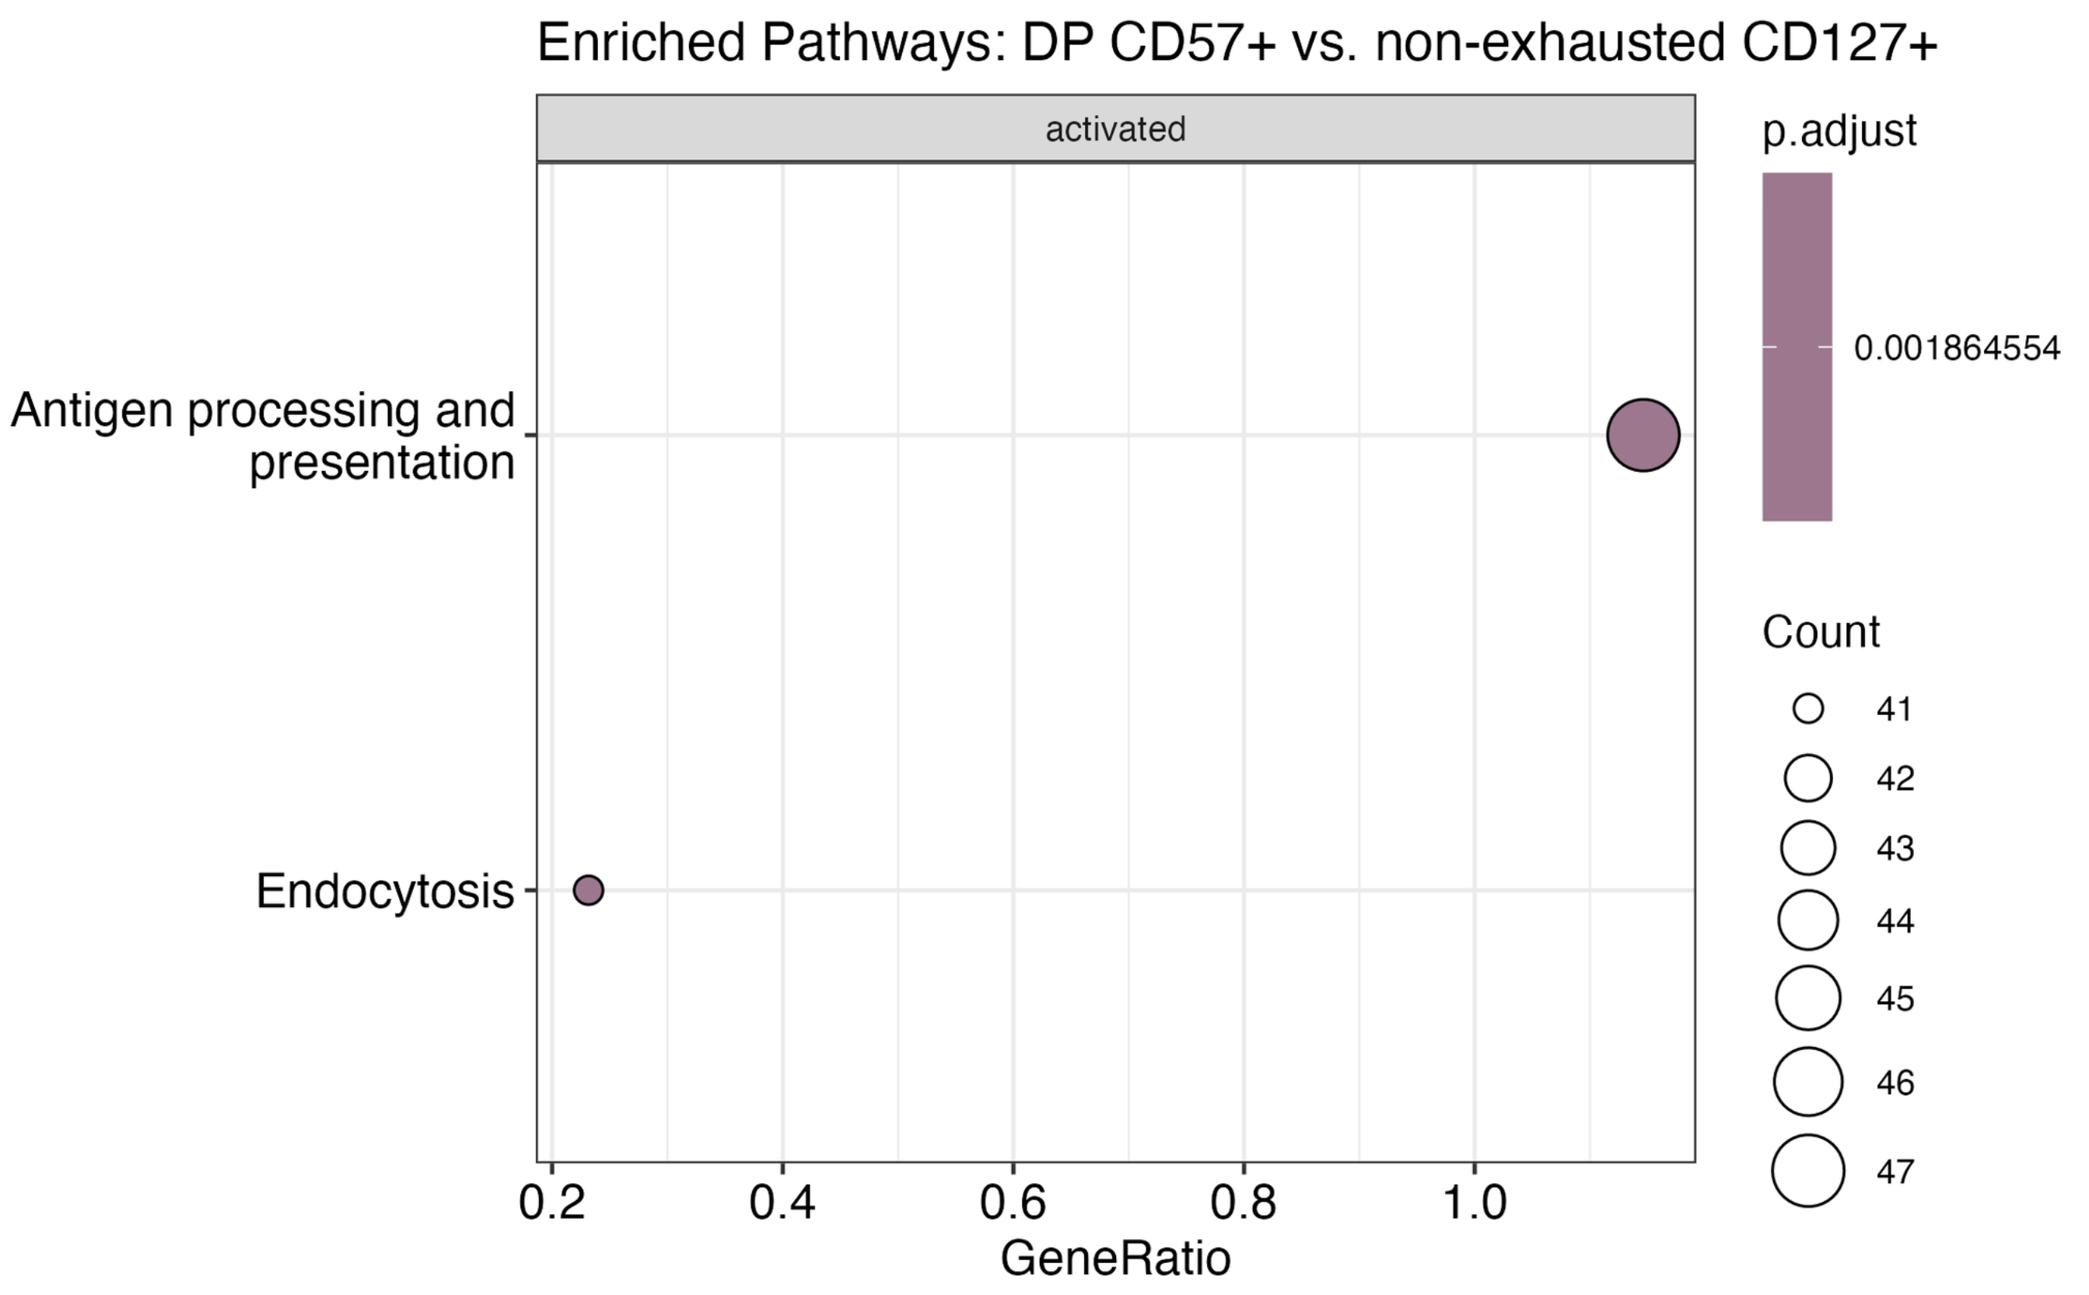
Cytotoxicity and exhaustion genes more accessible in DP CD57⁺ relative to non-exhausted CD127⁺

Slide 16
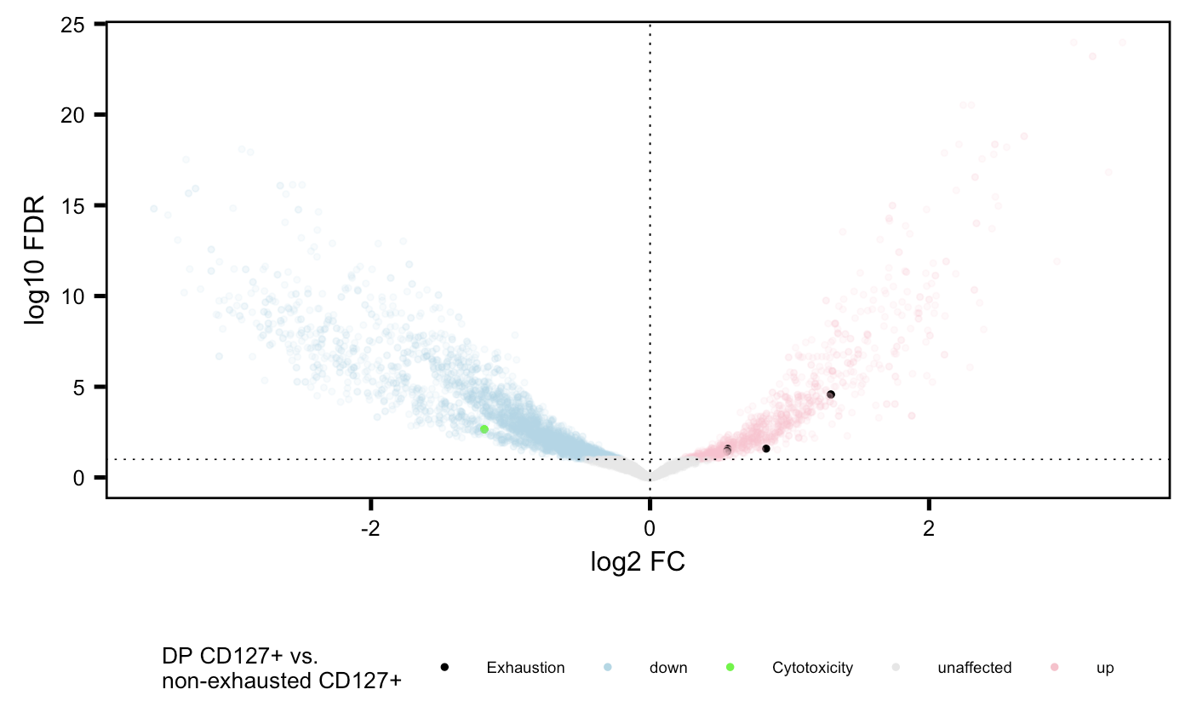
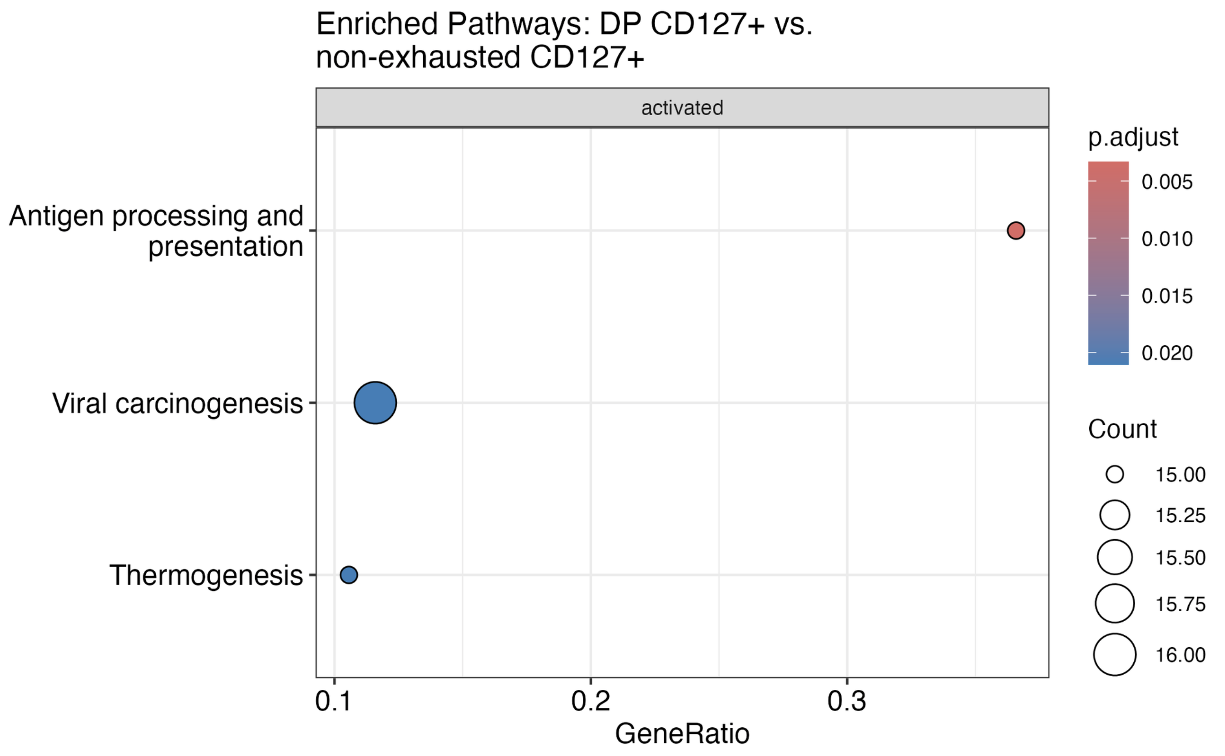
Exhaustion genes more accessible in DP CD127⁺ relative to non-exhausted CD127⁺

Slide 17
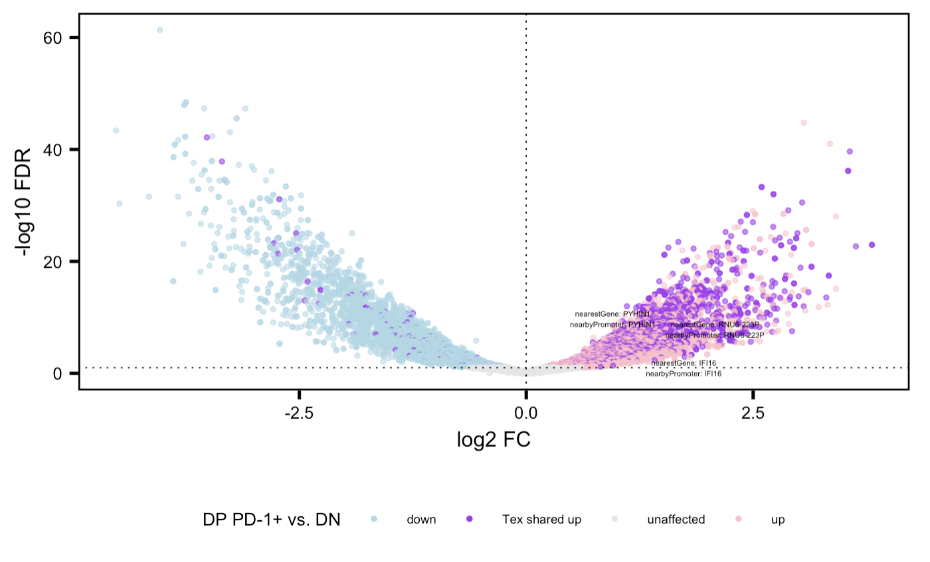
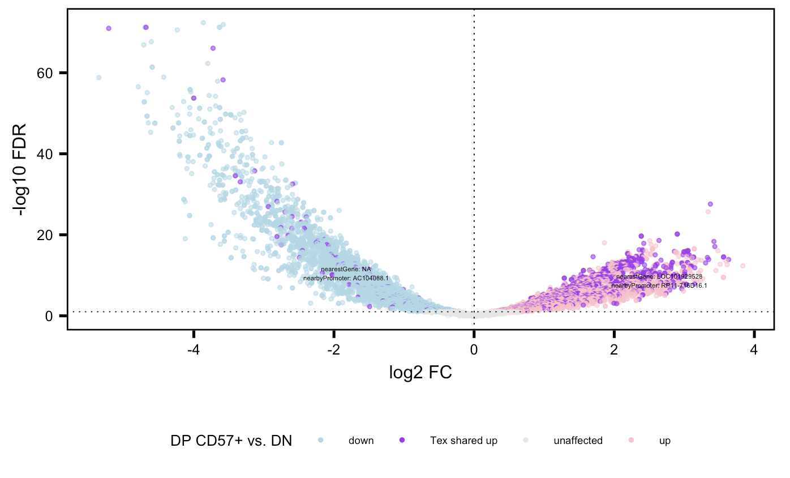
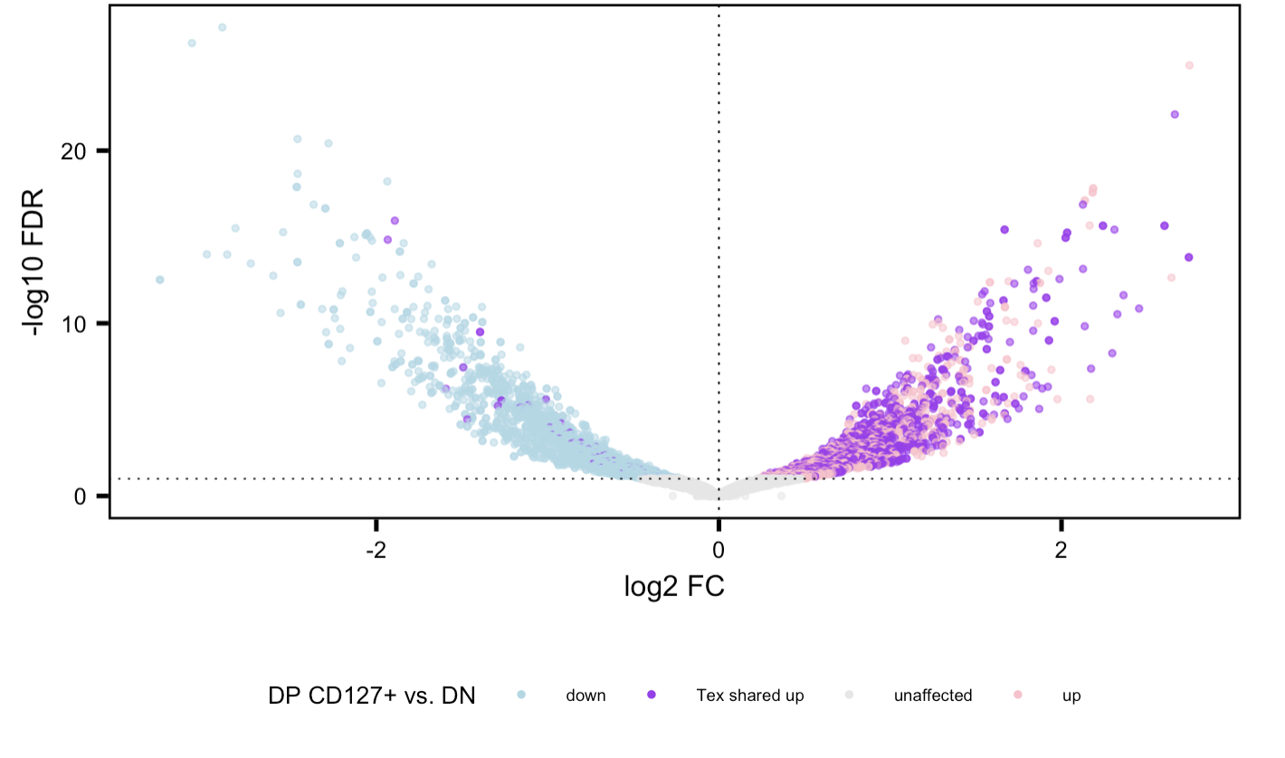
High degree of sharing of up (not necessarily not down) genes b/w 3 cell sorts, more additional unique DARs in DP CD57⁺ consistent across projects
Methods:
1. Filter peaks for positive log2 FC and FDR < 0.05 in each sort vs. DN
2. then look for genes appearing at least once in all 3 lists = T_{ex} shared “up”
Notes:
Erin also saw more sharing dominance in PD-1+ vs CD57+ (i.e. more purple), evident here too

Slide 18
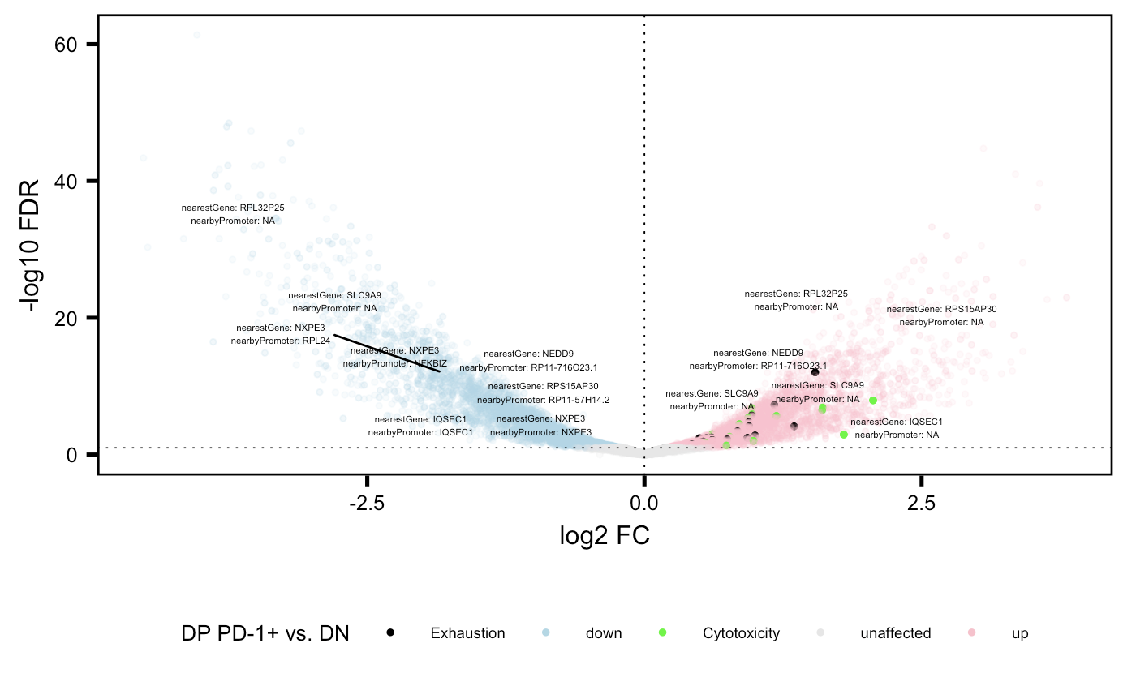
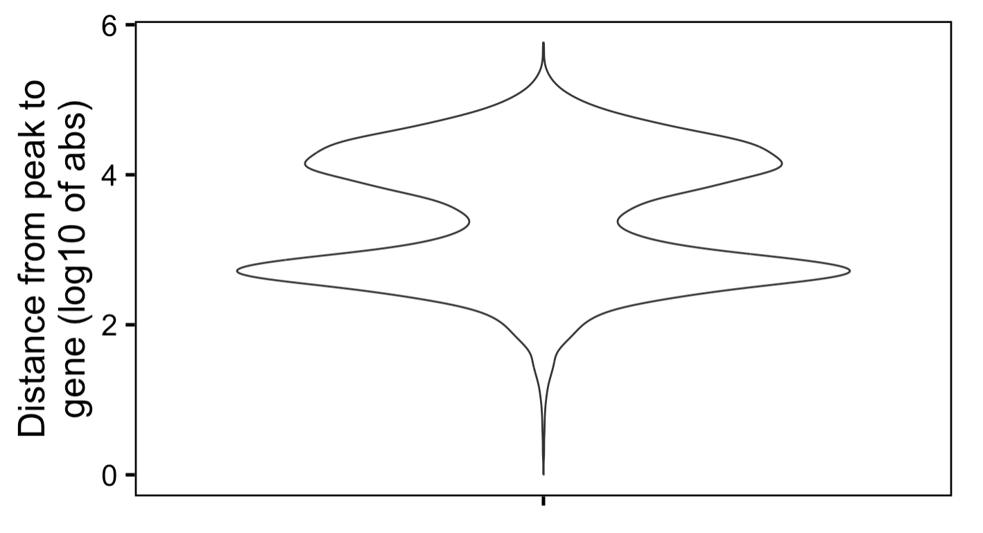
Examples of genes with both sign FCs, seems to be more common at lower abs(FC), most are peaks far away from genes (> 5 kb, although that describes most peaks anyways)
Notes:
Biologically interesting, like bivalent chromatin?

Slide 19
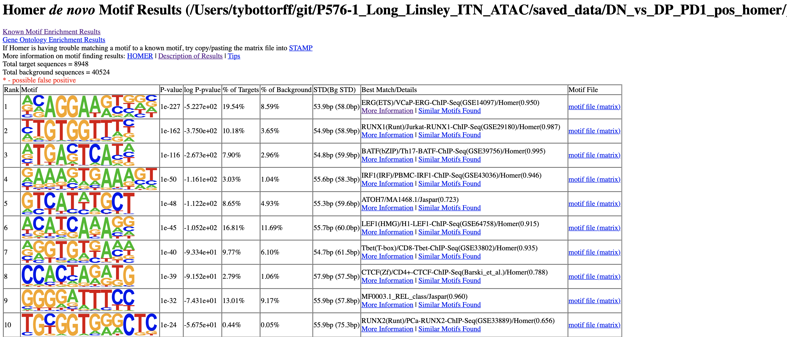
Preliminary TF analysis (DP PD-1⁺ vs. DN)
Notes:
Tbet being a hit makes sense (exhaustion TF, up in DP vs. DN)
lower read depth in p576 may affect p452 comparisons

Slide 20
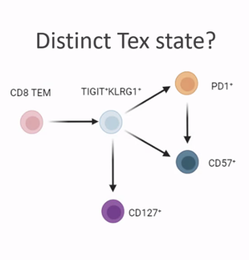
Conclusions
Similar cell sort PCA/VP comparisons look similar b/w P576 and P452
New cell sort comparisons
Cytotoxicity and exhaustion genes more accessible in…
DP and non-exhausted CD127⁺ relative to DN
DP CD57⁺ relative to DP CD127⁺
DP PD-1⁺ and DP CD57⁺ relative to non-exhausted CD127⁺
Cytotoxicity genes more accessible in DP PD-1⁺ relative to DP CD127⁺
Exhaustion genes more accessible in DP CD127⁺ relative to non-exhausted CD127⁺
DP CD127⁺ appears to be distinct, non-intermediate cell state from but shares lineage with DP PD-1⁺ and DP CD57⁺
aa link TCR graph looks same as nt link TCR graph (not shown)

Slide 21
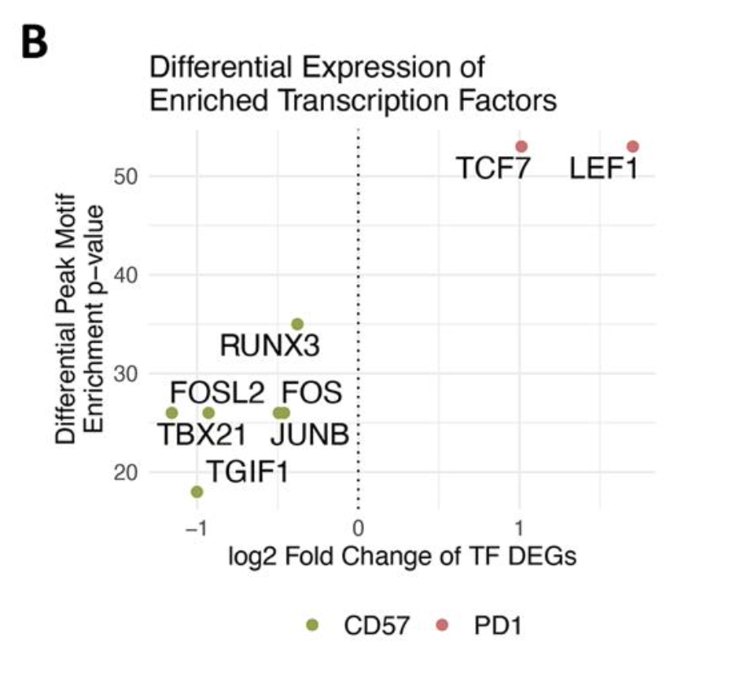
Next steps
VP DAR filtering → re-do VPs/KEGG?
“duplicates” i.e. distinct peaks but all closest to same gene and/or promoter… potentially have different sign FCs, potentially not closest to same gene AND promoter
Filter by distance from peak to gene?
More analysis on data similarity between same cell sorts in P576/P452?
Interpret KEGG results
Continue TF analysis (next try DP PD-1⁺ vs. DP CD57⁺ to compare to Erin’s)
irAE project: look for TIGIT⁺KLRG1⁺ CD8 frequency and/or EOMES level differences between irAE groups at baseline/on treatment, see if these relate to ICB response as well
Notes:
Expect red ones up in PD-1 vs. CD57+, green ones up in CD57+ vs. PD-1+ for homer TF stuff?

